Slide 1




RETSA Group Portfolio of Work
Introduction
Development Process
Veolia Australia & NZ
SUEZ Australia
eHealth NSW
Downer
Toyota
FlexiGroup
Various samples from previous projects.
Australian Hearing
BCA National
Testimonials

Slide 2
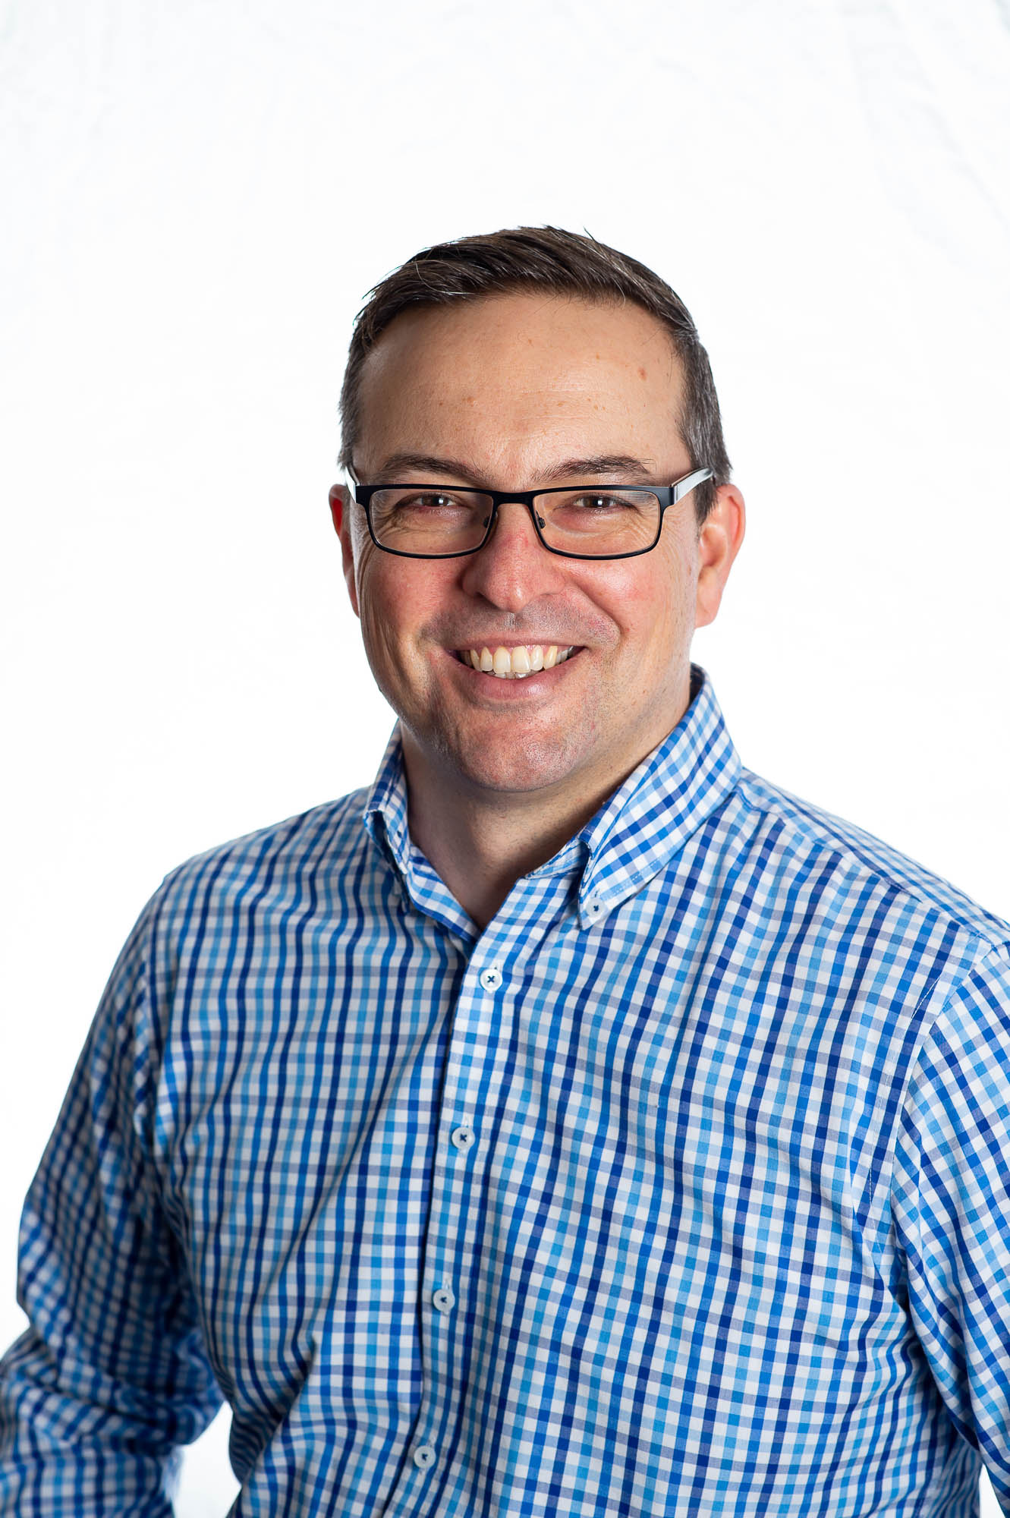
Thanks for viewing my portfolio.
My name is Marcus Rummler and I’m the Director of RETSA Group. We’re a business consultancy in the learning and development sector.
I’ve been working in the industry for over 10 years and I began my career as a workplace trainer. This enables me to understand learner needs and expectations.
We design and build learning solutions for our clients to help them solve business performance problems.
Let’s schedule a time to chat to see if we can help you.

Slide 3
High Level Development Process
Planning
Kick off meeting
Deliverables & Timelines
Storyboard
Collect content
Draft storyboard
Build
Choose our authoring tool
Build a prototype
Review
Usability of module
Content & User Reaction

Slide 4
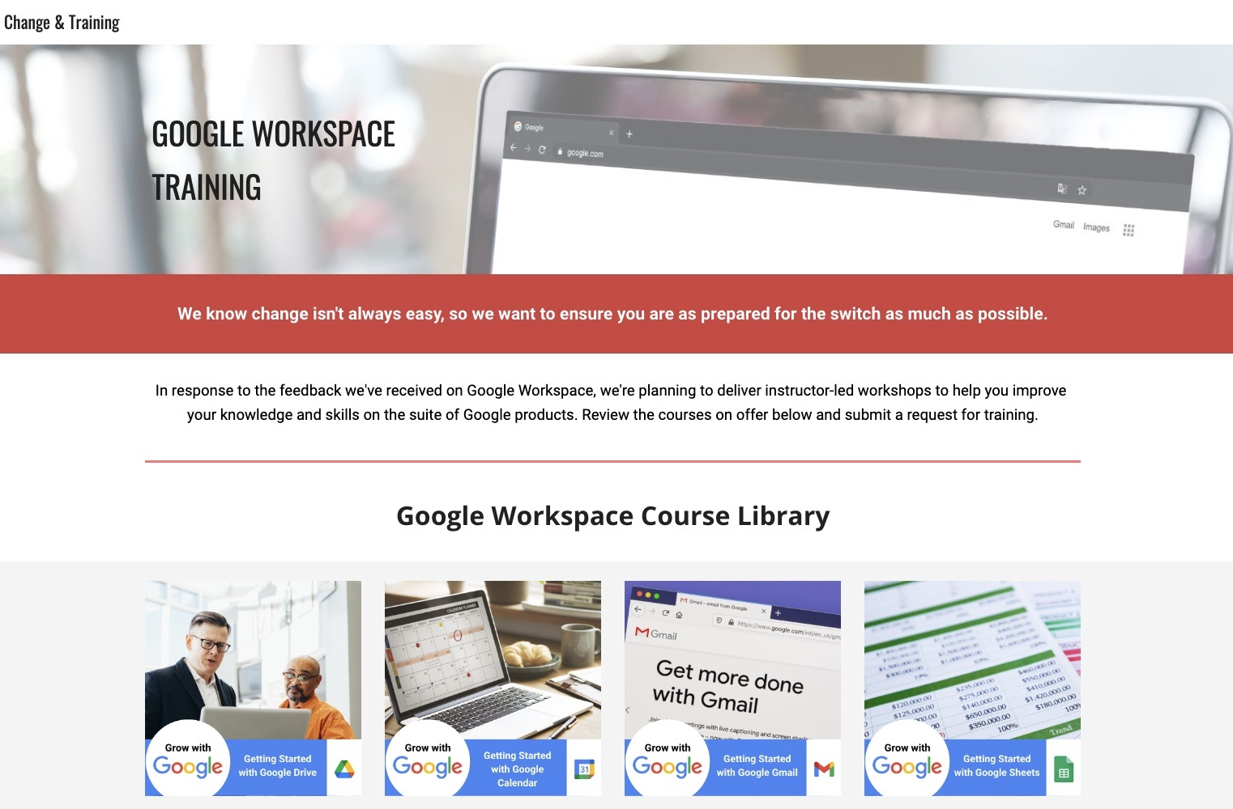
Veolia AU & NZ
Built using Google Sites.
I created an internal training page which contains a full course library on the Google Workspace courses on offer.
Developed unique course icons in Canva and page banner design.
Emphasis on strong visuals and reduced text.

Slide 5
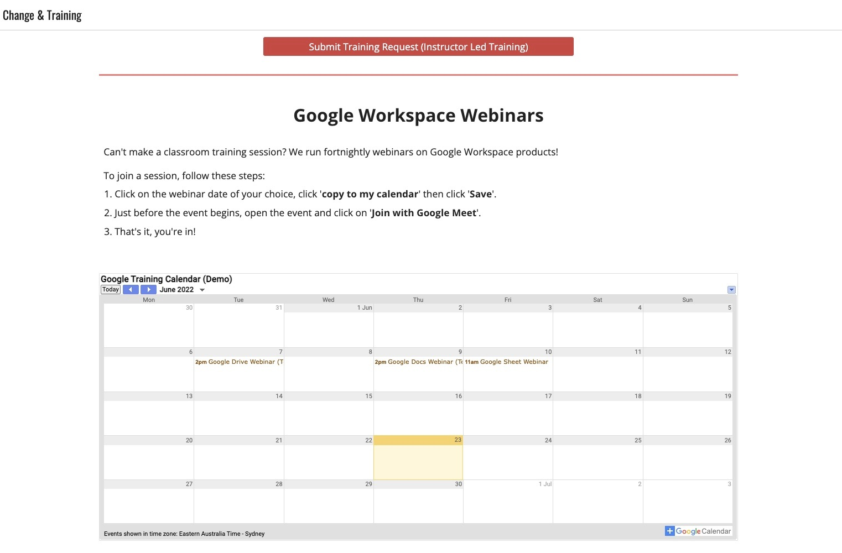
Veolia AU & NZ
Google Calendar integration.
Staff can join weekly webinars through an integrated calendar system for a seamless experience.
Staff simply hover the cursor of the calendar entry to view the training topics and book their session.
Emphasis on using existing Google apps.

Slide 6
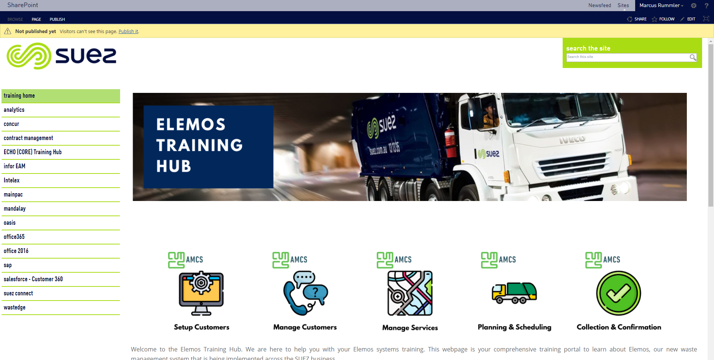
SUEZ Australia
Built in Microsoft SharePoint.
I created an internal training page on the Intranet to centralise our training materials and resources.
Developed unique icons in Photoshop and page banner design.
Emphasis on strong visuals and reduced text.

Slide 7
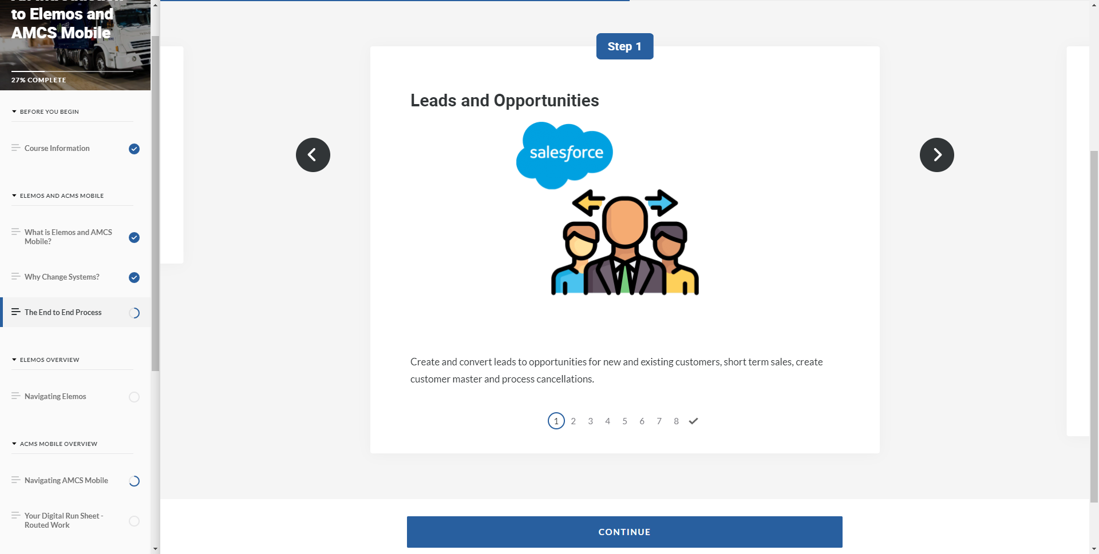
SUEZ Australia
I created an eLearning module using Rise for over 600 staff to complete as part of a blended learning program.
Features exploration activities and interactive elements.
Emphasis on strong visuals and key topics to prepare for classroom training.

Slide 8
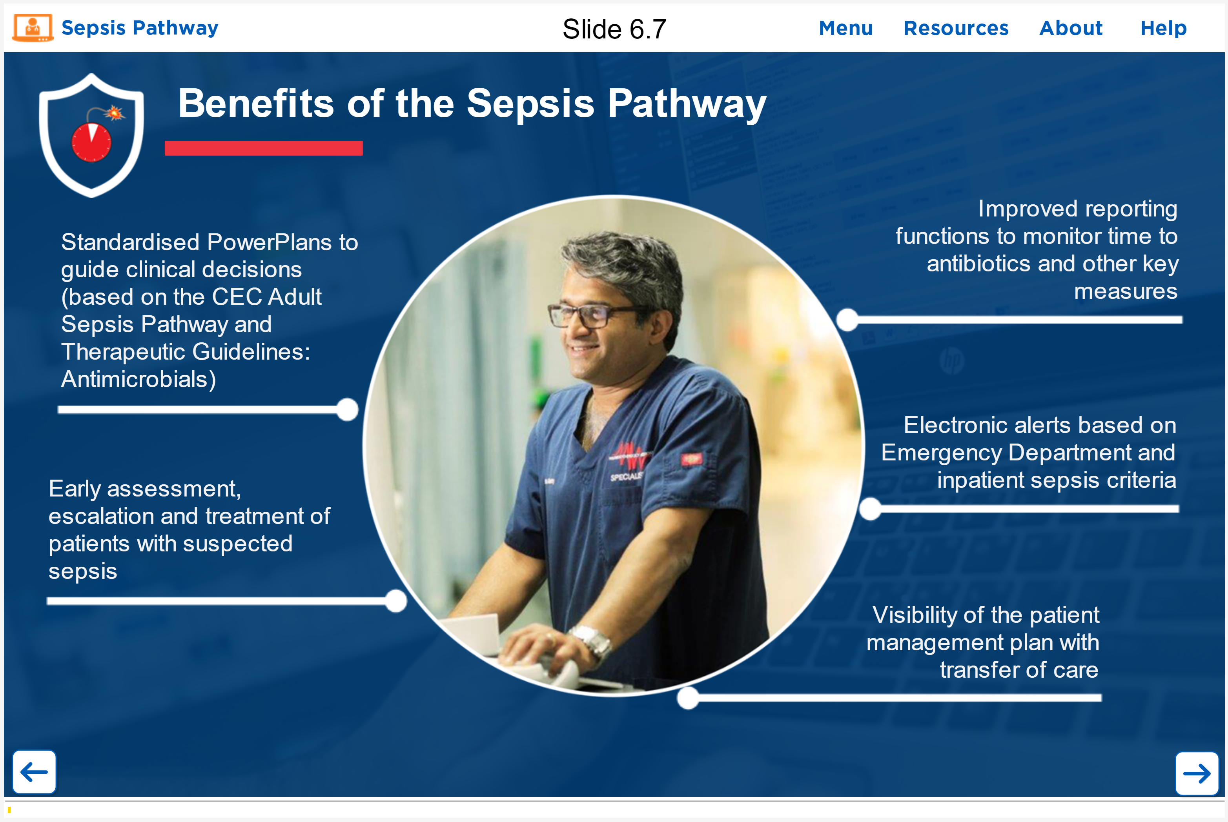
eHealth NSW
Built in Articulate Storyline.
I created a clipping mask in Adobe Photoshop to insert an image of a doctor within a shape.
Colours and icons are based on the eHealth colour palette.
Emphasis on strong visuals and reduced text.

Slide 9
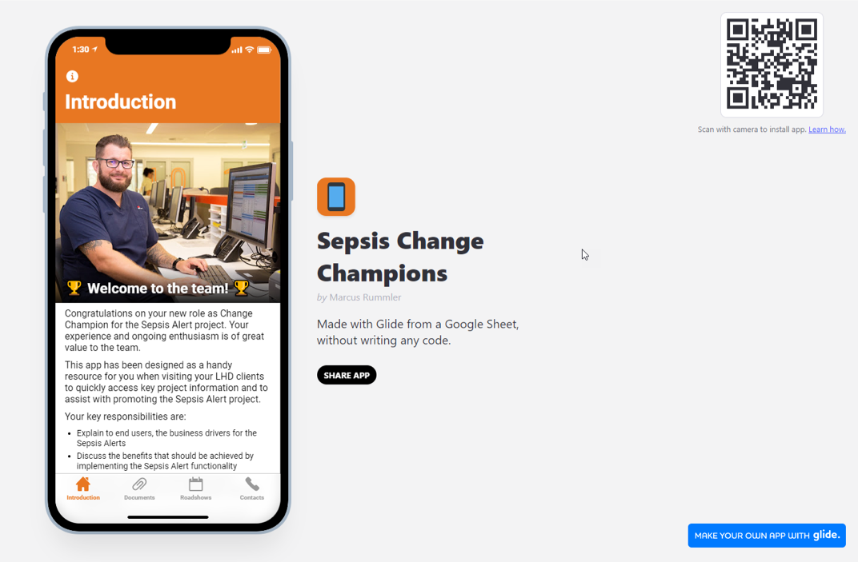
eHealth NSW
Built with Glide using a Google Spreadsheet.
Proof of concept design for the Sepsis Pathway pilot at Princes of Wales Hospital.
Mobile responsive design that is easily customised.
Accessed by QR code or URL and displays as a native app.

Slide 10
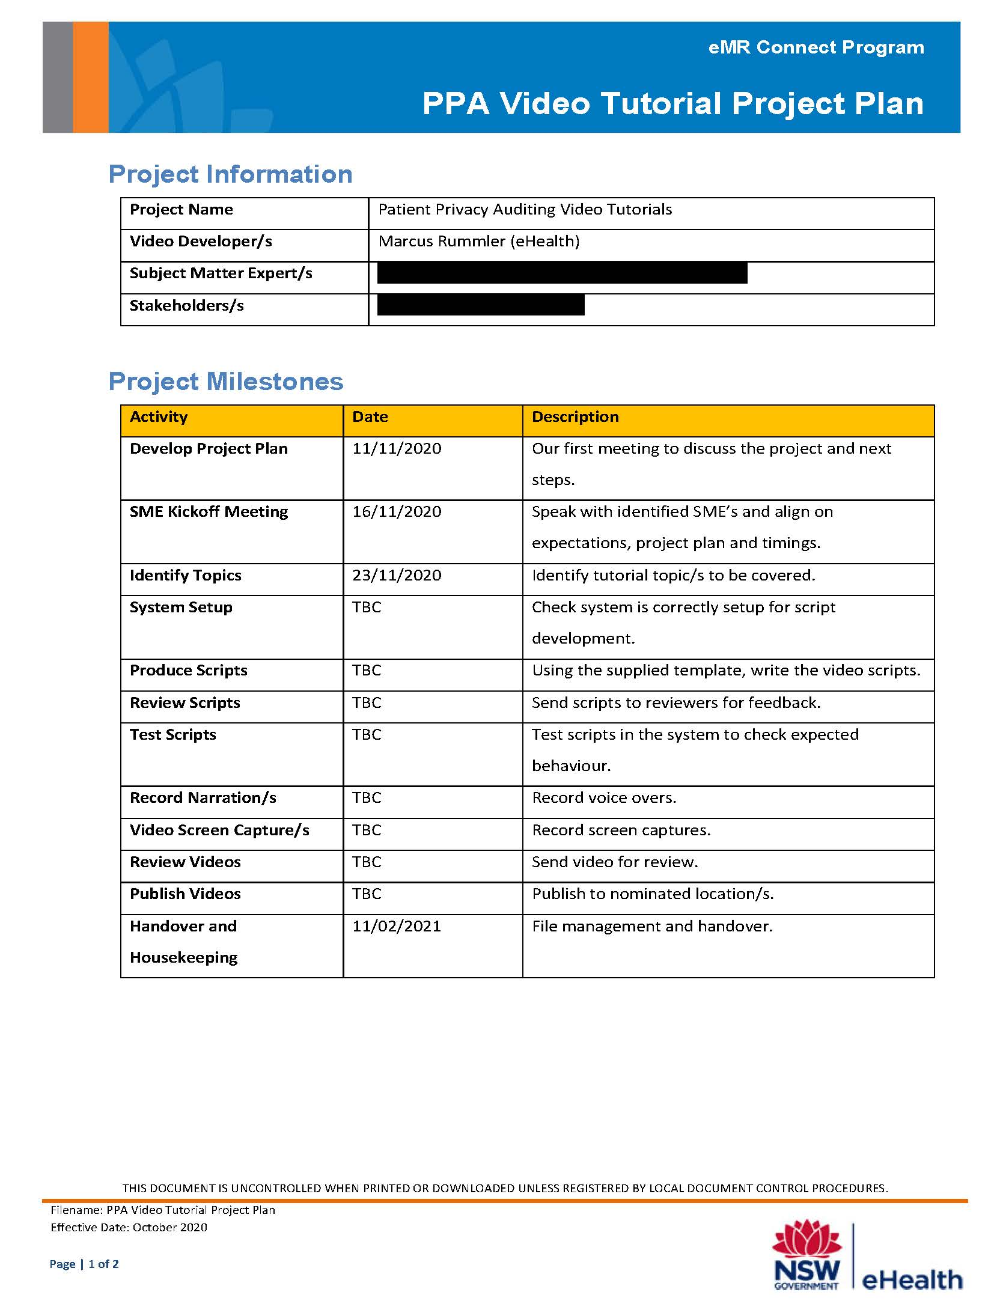
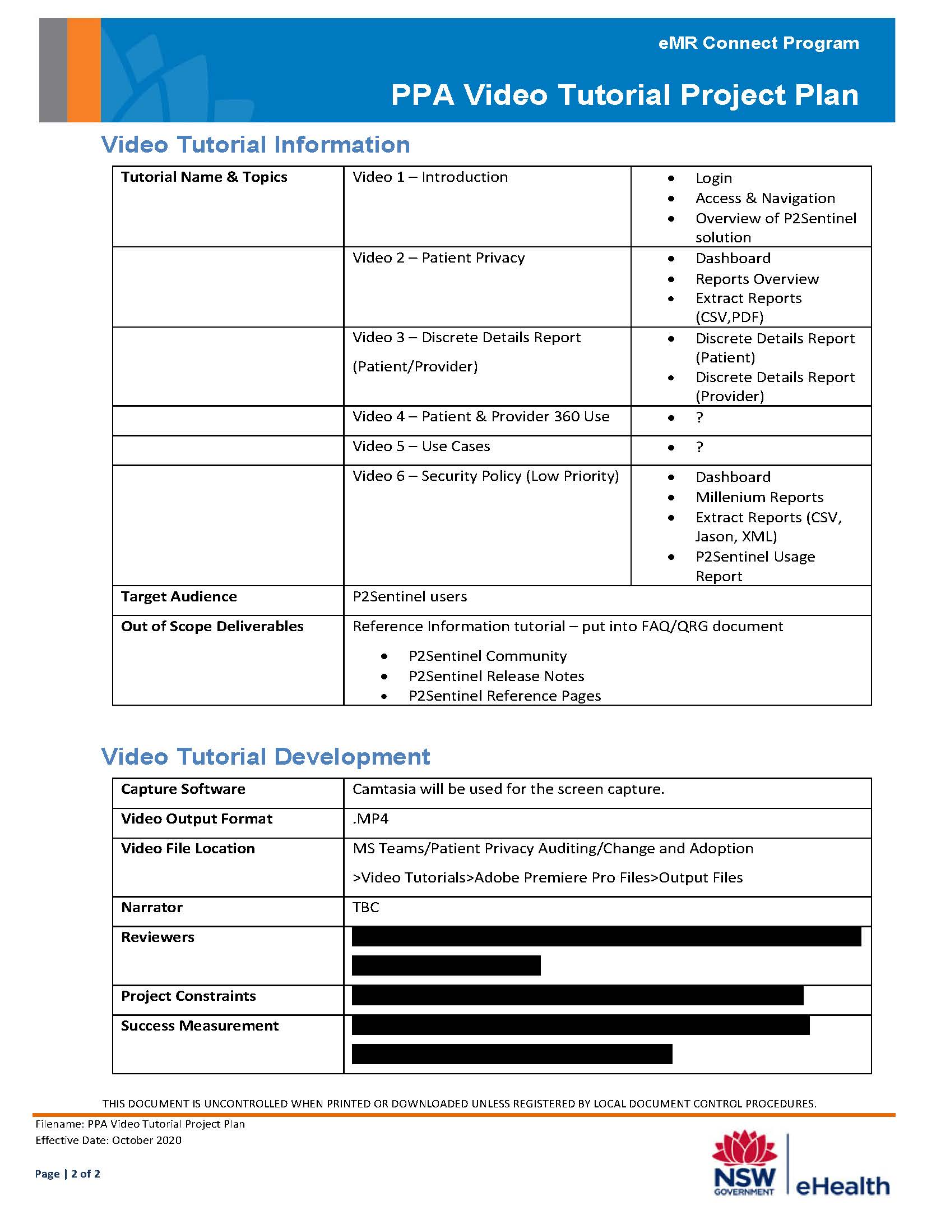
eHealth NSW
Video tutorial project documentation.
I created this documentation to assist the software development team with the management of their project.
Documents are customised for each project to ensure they are valuable to end users.

Slide 11
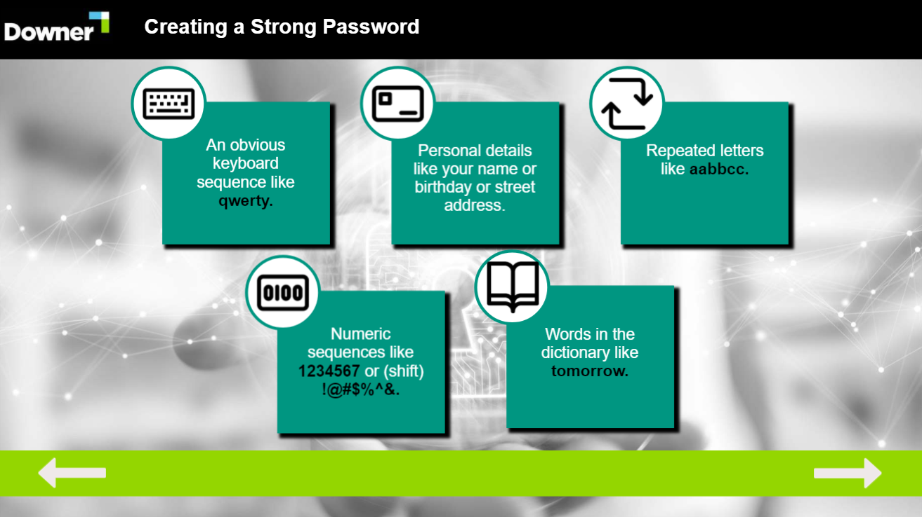
Downer
Built in Articulate Storyline.
Click and reveal interactions.
Client requested use of icons with minimal text.
Colours based on the Downer branding.
Stock images on base layer.

Slide 12
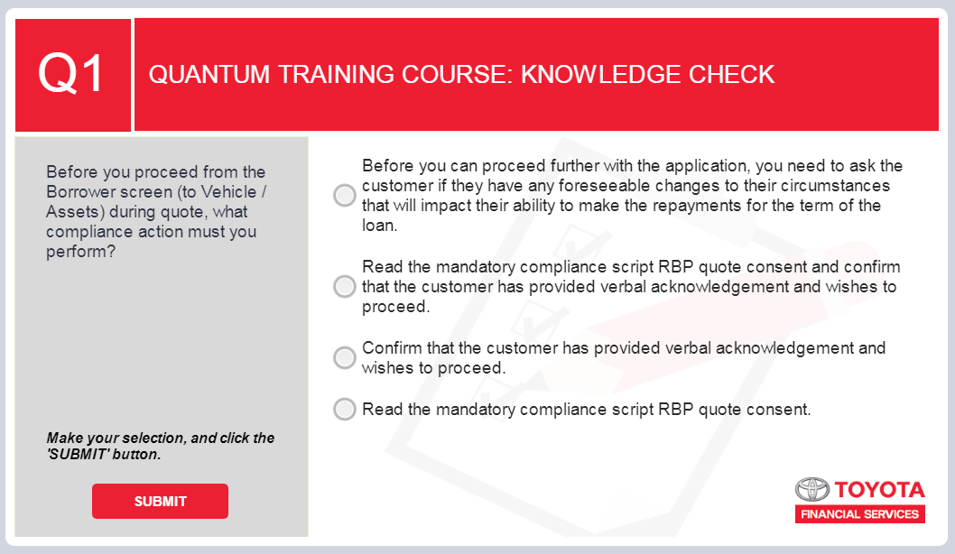
Toyota Finance
Built in Articulate Storyline.
Graded multiple choice assessment.
Each answer has specific feedback.
Colours based on the Toyota branding.
Image used on base layer for more visual appeal.

Slide 13
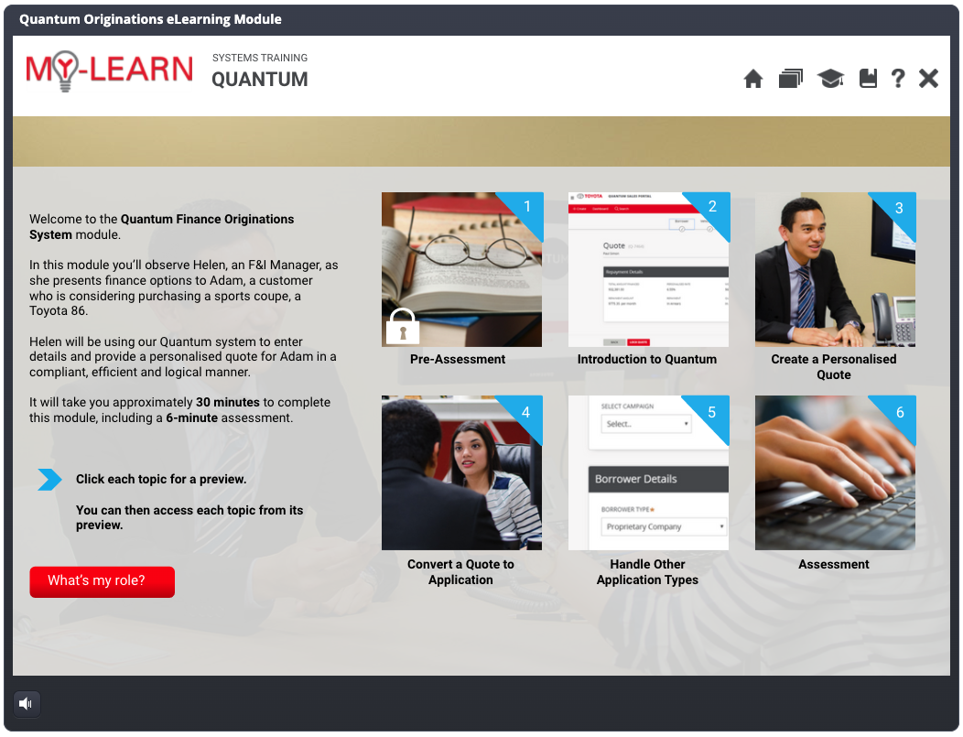
Toyota Finance
Built in Articulate Storyline.
Template supplied by TFS.
Each tile branches off to unique content.
Scenario based examples that simulate real world situations.
No stock photography used.

Slide 14
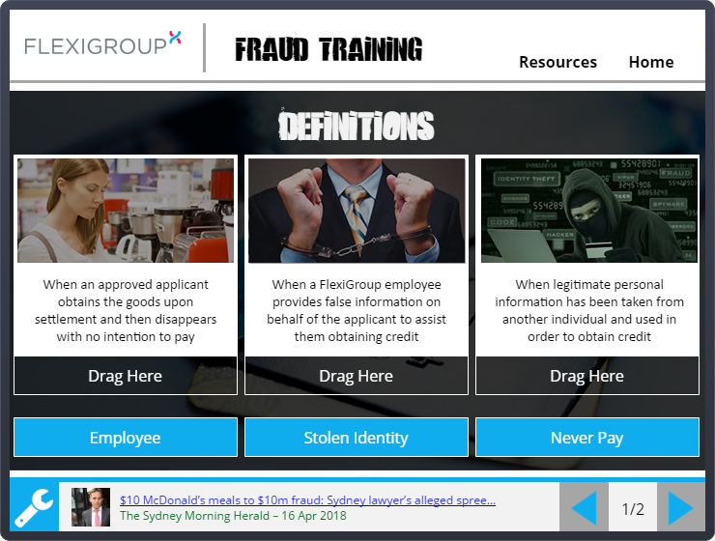
FlexiGroup
Built in Articulate Storyline using a drag and drop interaction.
Each answer has specific feedback.
Colours based on the FlexiGroup branding but design is all new.
Interactive news link feature linking real life stories to the module content and messaging.

Slide 15
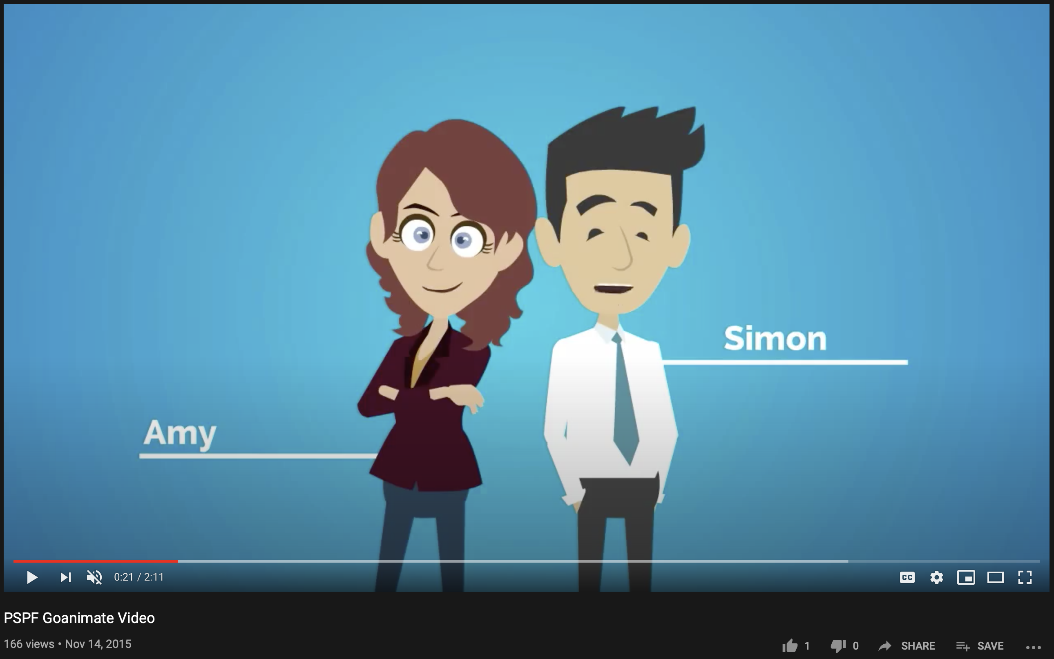
Australian Hearing
Built in Vyond (Goanimate).
Developed the entire script for the video and consulted with SME’s to validate.
Video was deployed to the intranet page to communicate the upcoming change and eLearning module.

Slide 16
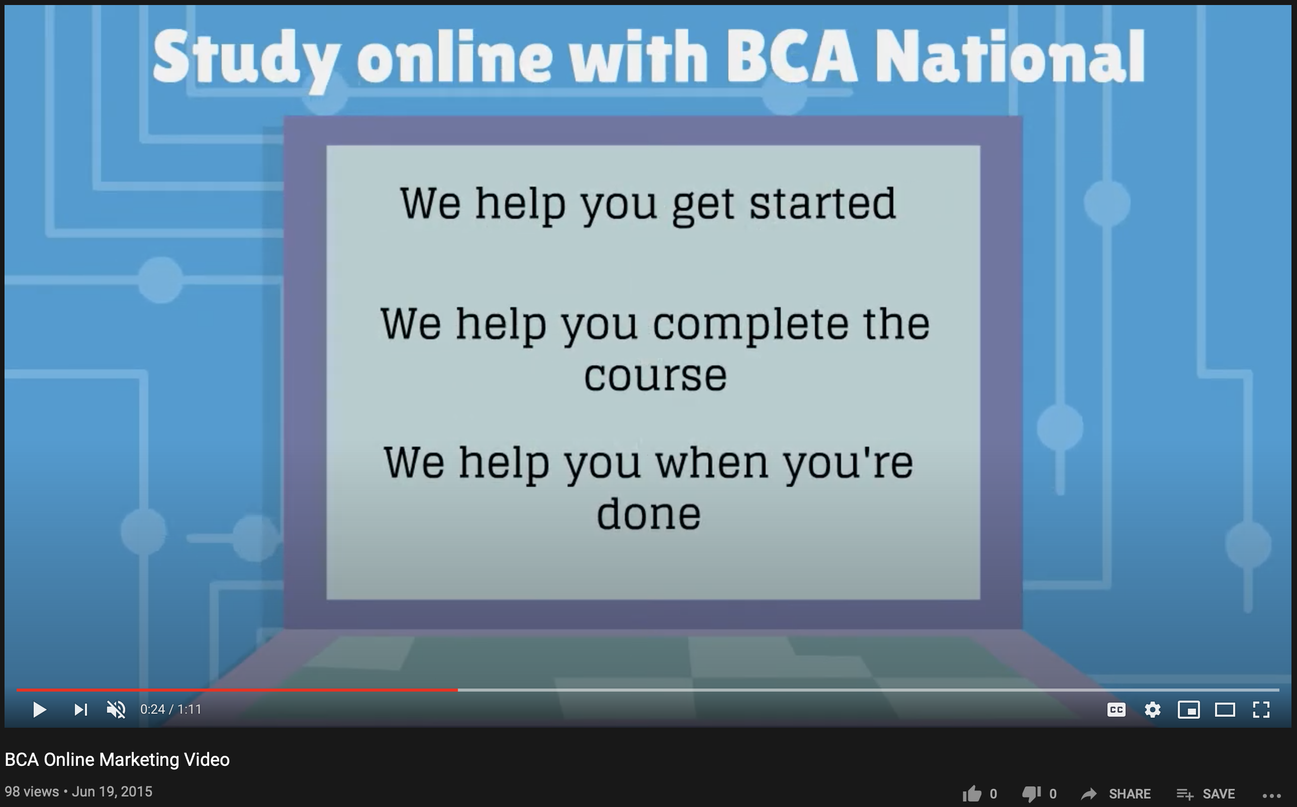
BCA National
Built in Vyond (Goanimate).
I developed the entire script for the video and consulted with subject matter experts to validate.
The video was published to the organization’s Facebook page public facing website.

Slide 17
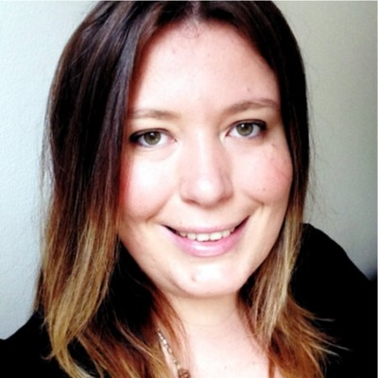
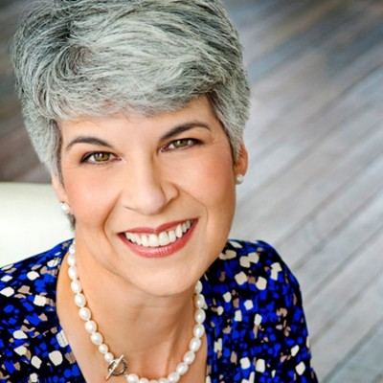
Testimonials
We worked together on a fairly complex project, with many moving parts and a diverse group of stakeholders. Marcus got up to speed quickly and wasn’t fazed by the changing landscape. His deliverables were high quality and thoughtfully tailored to the various audience groups. I happily recommend Marcus for his training expertise.
Adriana Jamieson – SUEZ AU
Kind words from some of the wonderful people we’ve worked with before.
I have worked with Marcus for nearly a year and found him a pleasure to work with. His 'can do' attitude made all the difference during high degree of business uncertainty due to covid and ongoing business change. I would definitely recommend his services to anyone who is looking to lift their training outcomes and gain higher engagement.
Diane Gatto – SUEZ AU

Slide 18
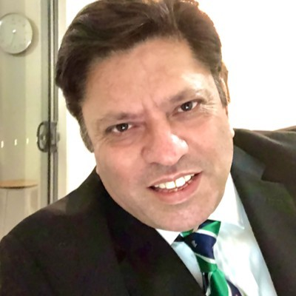
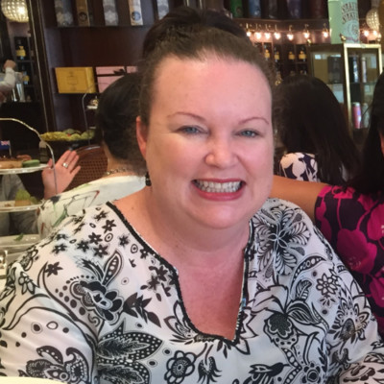
Testimonials
Marcus is meticulous, matchless and marvellous. He has a great positive attitude, and you will always find him smiling and enjoying his work. I highly recommend him for any eLearning, video, or project and would love to have him in my team in the future.
Kevin Kayani – eHealth NSW
Kind words from some of the wonderful people we’ve worked with before.
I’ve had the pleasure of working with Marcus for several months. He is an exceptional learning practitioner with sound adult learning knowledge, a true professional committed to the best outcome for all parties. His creativity and ability to take an existing eLearning module and turn it into a highly sophisticated, engaging learning experience is impressive. I would be delighted to work with Marcus again.
Stephanie Taylor– FlexiGroup

